Slide 1
Service Bench Guide

Slide 2
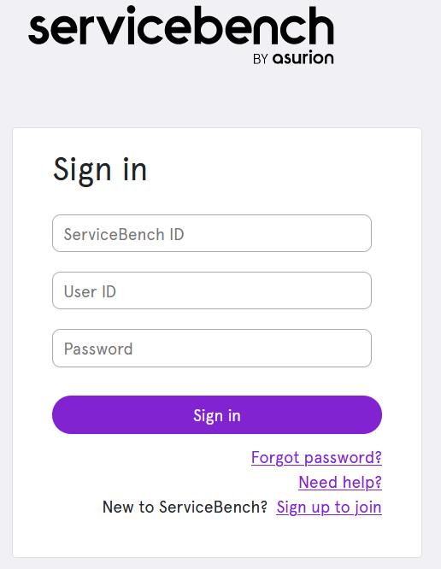
Creating & Logging into your Service Bench Account
Contact your Warranty Administrator, who will create your login credentials if you’ve never accessed Service Bench.
Central Texas: Lisa.Rodriguez@rmadden.com or 512.442.9000 ext. 7421
Central Texas: Malissa.Howe@rmadden.com or 512.442.9000 ext. 6433
San Antonio & West Texas: Ernestina.Mendez@rmadden.com or 806.797.4251 ext. 1228
Once you have your login credentials, go to Servicebench.com
Enter your Service Bench ID, User ID, and Password

Slide 3
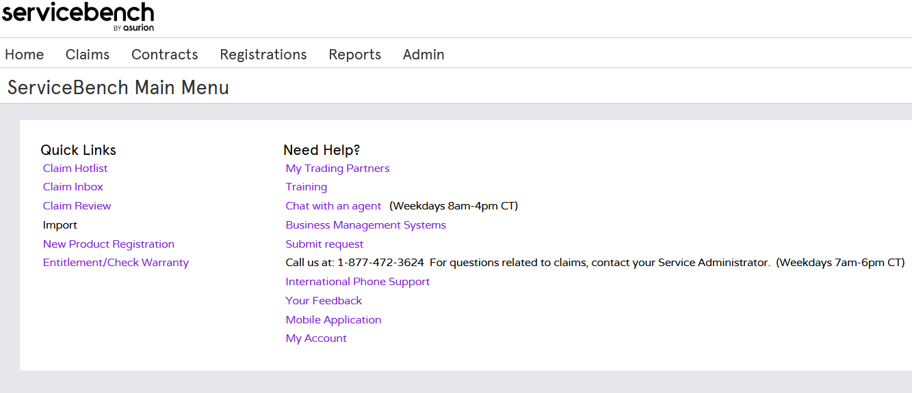
Checking Equipment Warranty Status
Once logged in, select Entitlement/Check Warranty from the Quick Links on the homepage
Click Entitlement/Check Warranty

Slide 4
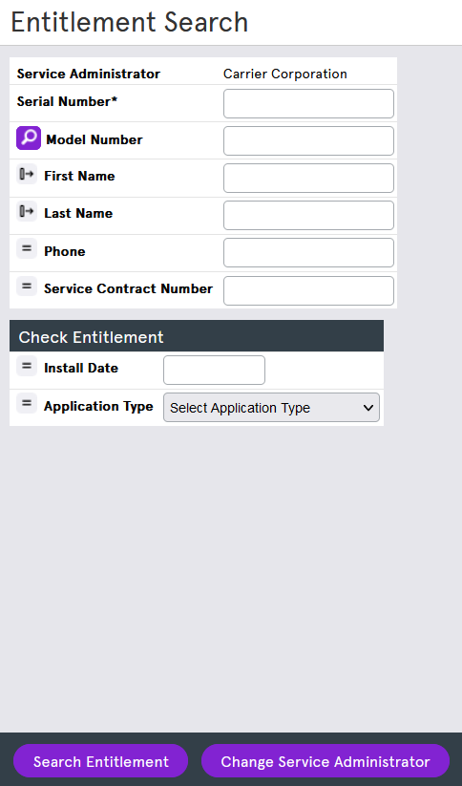
Checking Equipment Warranty Status
Enter Product Serial Number
Do not enter the model number
After entering your serial number, click “Search Entitlement” or hit enter.

Slide 5
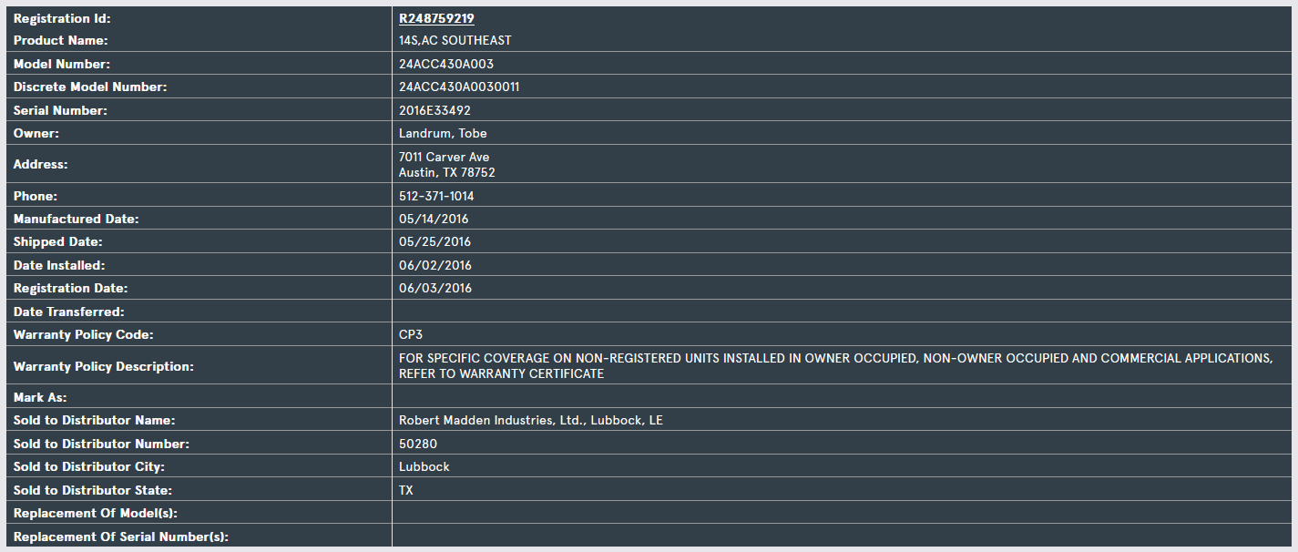
Checking Equipment Warranty Status
Once the serial number search returns, you’ll have access Model & Serial number, Homeowner information, Install Date, and Warranty Information.
Model Number
Serial Number
Install Date
Warranty Information

Slide 6
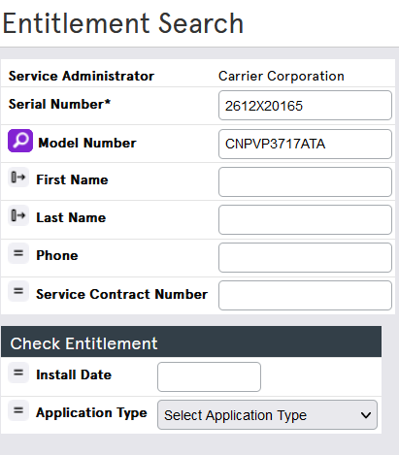
Checking Equipment Warranty Status
If the Serial Number is not registered, you must enter an Install Date and Application Type.
Note: Commercial applications has a one-year parts warranty from date of install.
Enter Install Date
Enter Application Type

Slide 7
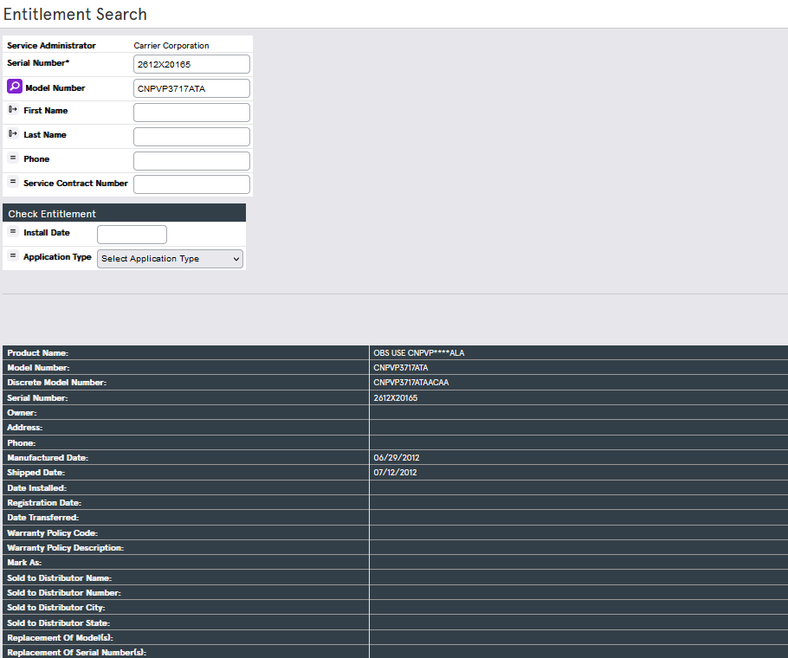
Submitting a Claim
Once you have determined the equipment is under warranty, you may begin a claim.
Select Start New Claim

Slide 8
Submitting a Claim
Once you have determined the equipment is under warranty, you may begin a claim.
Your account information will display here.
Dealer Name & Number
Dealer City Location
Required Field – Ex. Your PO #
Required Field
Required Field if Not Registered

Slide 9
Submitting a Claim - Continued
If the equipment isn’t registered, you’ll need to complete the Install Address, City, State, Zip, and Original Equipment Owner sections.
Required Field if Equipment isn’t registered
Required Field if Equipment isn’t registered
Required Field

Slide 10
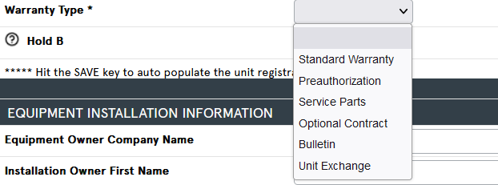
Warranty Types
There are two primary Warranty Types you will use, please contact your warranty administrator for instructions on any other types of warranty claims.
Standard Warranty: Parts-only coverage defined by the terms and conditions in the warranty card.
Service Parts: The base model & serial number is out of warranty, but the failed part was purchased and installed within the past 12 months.
Note: Contact your distributor for instructions on any other types of warranty claims.

Slide 11
Standard Claiming
Required Field
Required Field
Required
Required
Required
Required
Required
Ensure Box is Checked
Required only for Serialized Parts
Required only for Serialized Parts

Slide 12
Service Parts Claiming
Required Field
Required Field
Required
Required
Required
Required
Required
Required
Ensure Box is Checked
Required only for Serialized Parts
Required only for Serialized Parts
Part must be within 12 months of the failed date.

Slide 13
Submitting a Claim - Continued
Required Field – Please complete diagnosis with as much detail as possible.
Required Field
Notes:
1.) Click save to check for errors. Your claim number will be displayed as well.
2.) Then click Submit, you’re now done with your claim.

Slide 14
Warranty Claim Status
Paid
The claim has been approved, and reimbursement has been made to Robert Madden Industries.
Approved
The claim has been approved and waiting to be processed through the weekly payment cycle; (typical payment cycle = claims approved Thurs thru Wednesday are paid on Friday)
Requires Review
The claim has been sent to either RMI or Carrier for review.
Rejected
The claim did not meet all system (policy) validations or lacked the required information.
Corrected
The rejected claim has been resubmitted on a different claim number.
Saved
The claim has been started by the dealer or RMI but has yet to be submitted.

Slide 15
Claiming Tips and Best Practices
Make sure the required claim information is complete and accurate.
Use the entitlement screen to start the claiming process.
Claims should be submitted within 90 days of the repair date to avoid rejection.
Add claim comments to communicate relevant information or unusual circumstances.

Slide 16
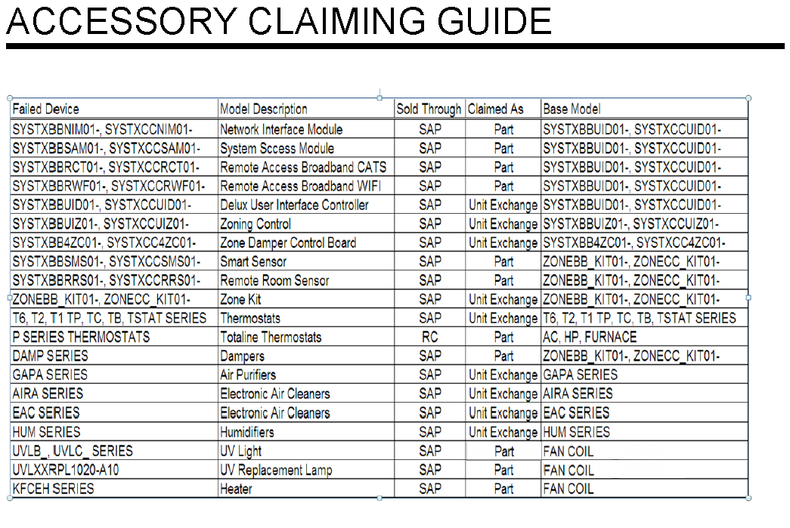
Accessory Claiming Guide

Slide 17
Product Registration
Registrations must be completed within 90 days of install for equipment to qualify for enhanced warranty.
Registrations submitted via the consumer websites will transfer to the Service Bench system soon after completion.
Changes within 90 days of registration can be made through the equipment consumer websites. Changes after 90 days of registration have to be submitted to the Warranty Administration group. Please provide all of the information necessary to make these corrections.
A registration will be created in Service Bench after the first claim or contract registration.

